Slide 1
CAPSTONE TABLEAU DATA ANALYSIS PROJECT
-ANIKET CHOWDHURY

Slide 2
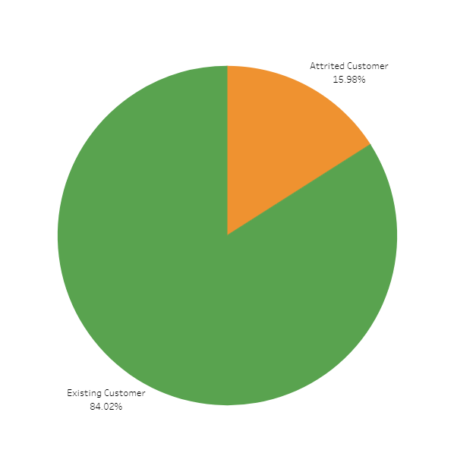
INTERPRETATION
A pie chart showing the percentage of attrited(15.98) versus existing(84.02) customers.

Slide 3
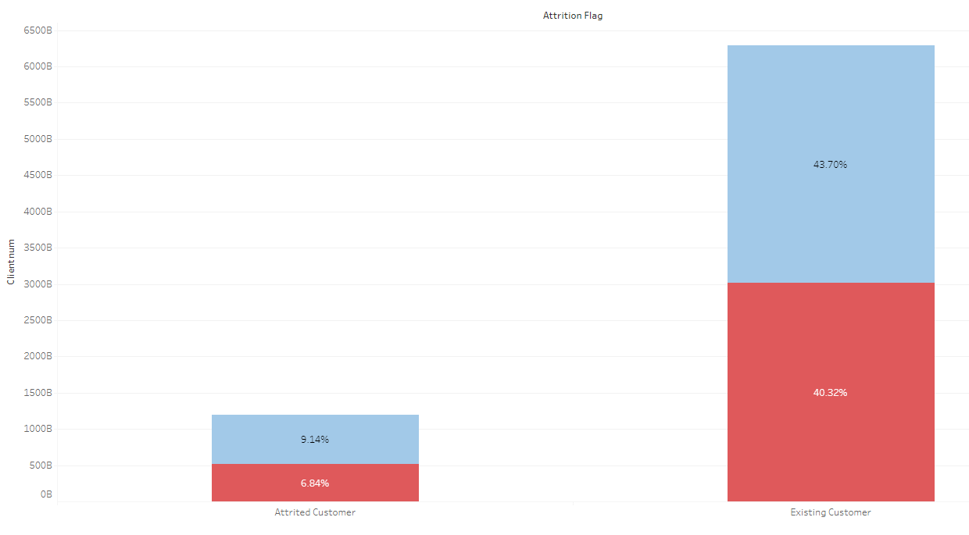
INTERPRETATION
A bar chart showing the percentage of attrited versus existing customers by gender.

Slide 4
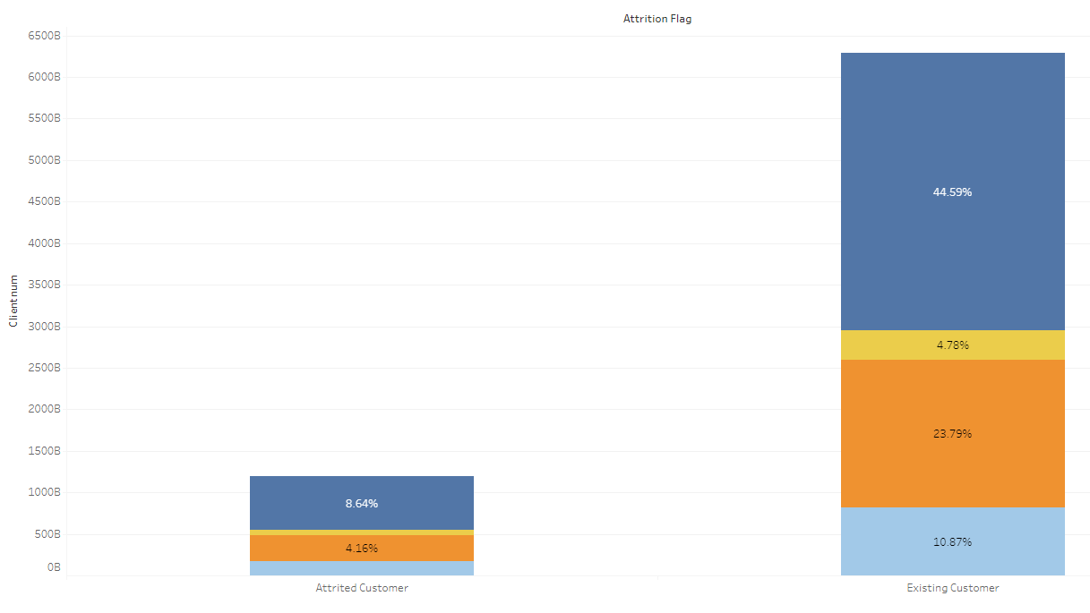
INTERPRETATION
A bar chart showing the percentage of attrited versus existing customers by region.

Slide 5
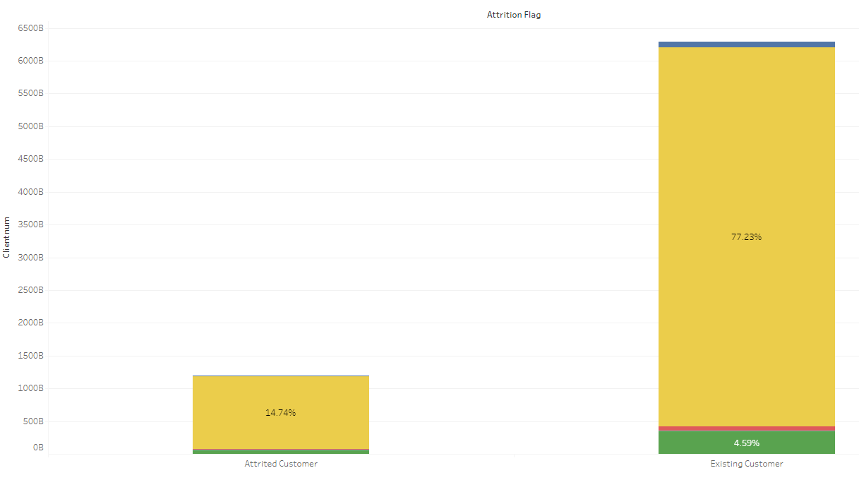
INTERPRETATION
A bar chart showing the percentage of attrited versus existing customers by card category.

Slide 6
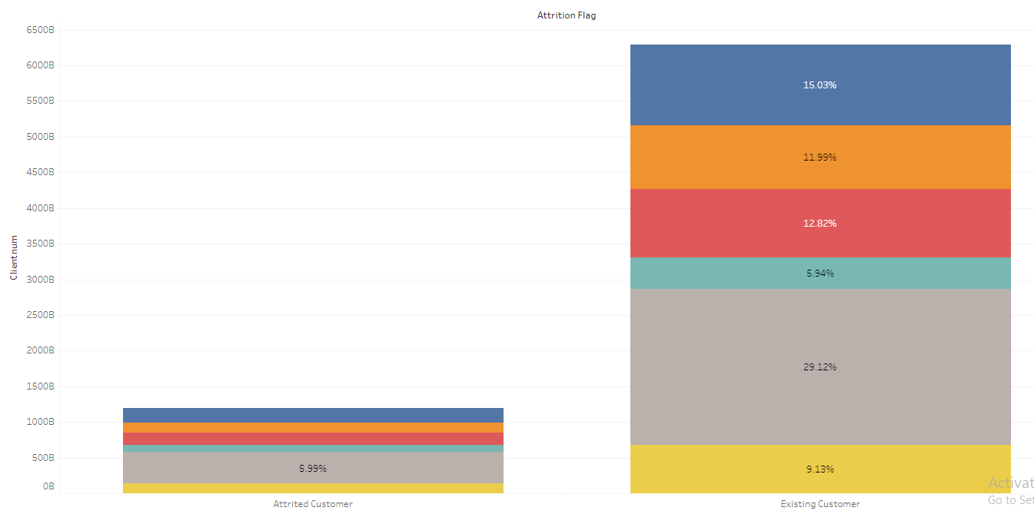
INTERPRETATION
A bar chart showing the percentage of attrited versus existing customers by income category.

Slide 7
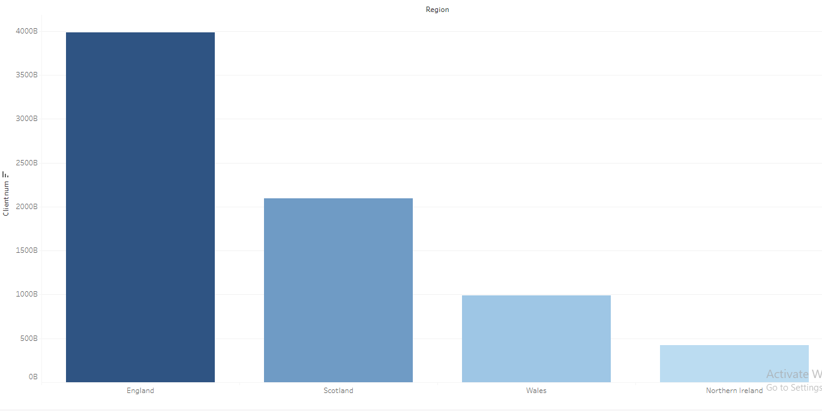
INTERPRETATION
A bar chart showing the attrition count by region in descending order.

Slide 8
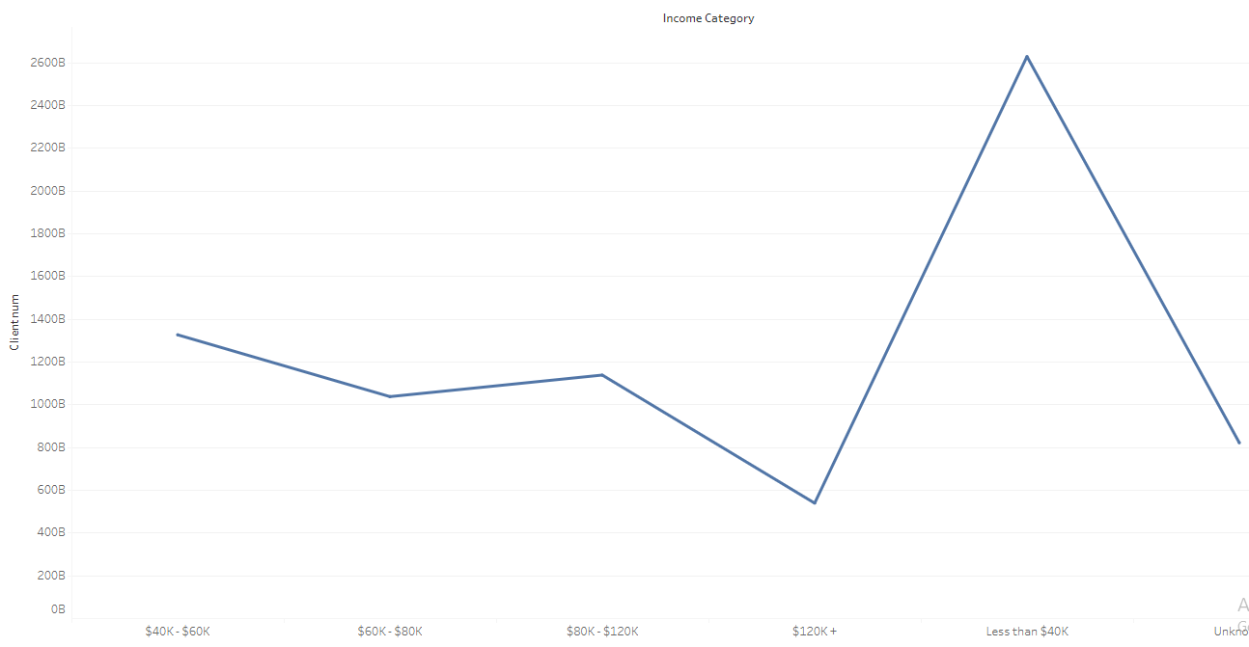
INTERPRETATION
A line chart showing the count of customers by income category.

Slide 9
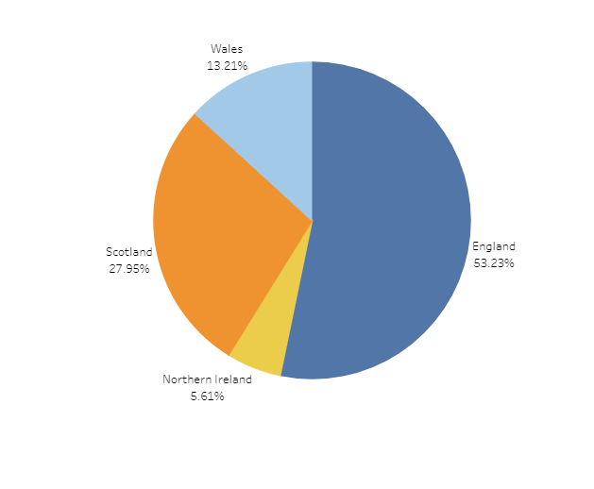
INTERPRETATION
A pie chart showing the count of customers by region.

Slide 10
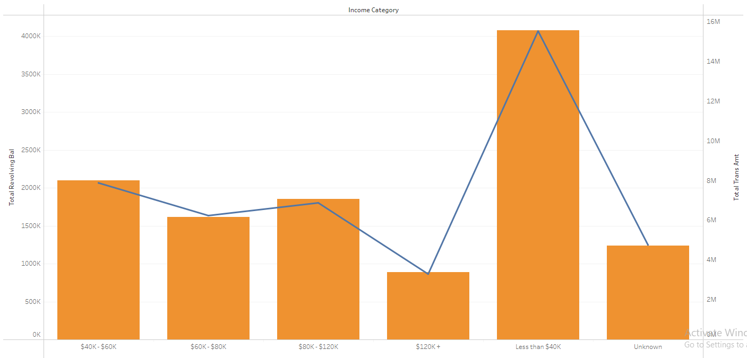
INTERPRETATION
A dual axis chart showing the revolving balance and transfer amount by income category.

Slide 11
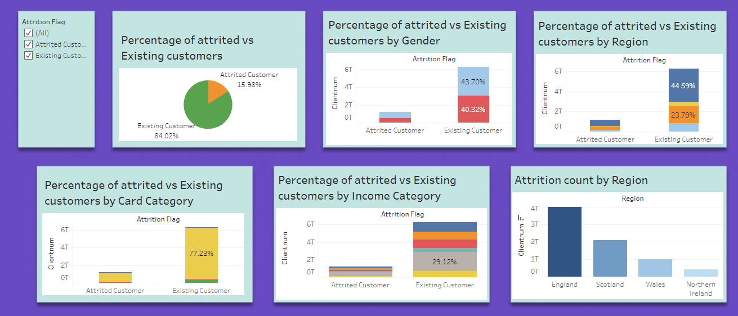
INTERPRETATION
A dashboard showing the percentage of attrited versus existing customers by different categories.

Slide 12
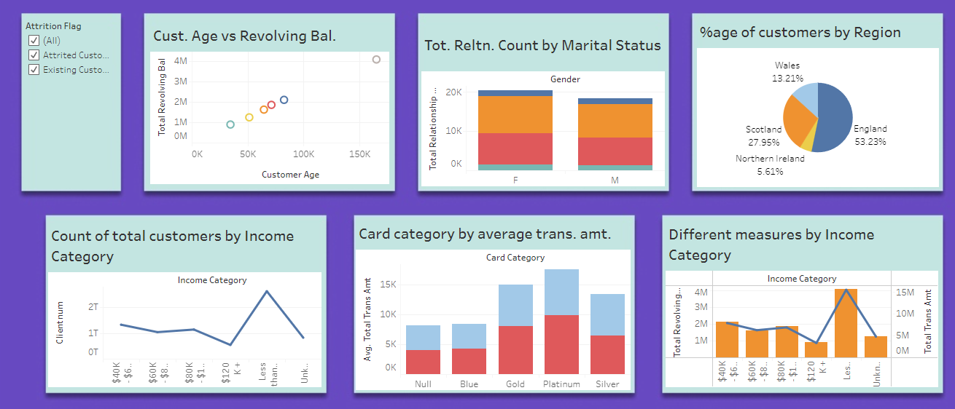
INTERPRETATION
A dashboard showing the relation between different measures.

Slide 13
THANK YOU

